Slide 1

Two Pointer technique
Programming Club, Akgec.

Slide 2
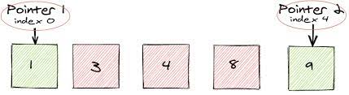
Introduction -
The name “two pointer” itself suggests what it does. It’s the the use of two different pointers (variables) to solve problems involving said indices with the benefit of saving time and space.
We usually start from the first index and iterate through the data structure one or more times depending on how we implement our code.

Slide 3
Illustration -
Given a sorted array A (sorted in ascending order), having N integers, find if there exists any pair of elements (A[i], A[j]) such that their sum is equal to X.
BRUTE FORCE APPROACH :
Iterate over i and j inside two for loops and check arr[i]+arr[j] == sum ,if yes return true.
Time Complexity: O(n*n).
Auxiliary Space: O(1)

Slide 4
CODE (NAIVE APPROACH) -
bool isPairSum(int A[], int N, int X){
for (int i = 0; i < N; i++) {
for (int j = 1; j < N; j++) {
if (A[i] + A[j] == X) return true;
if (A[i] + A[j] > X) break;
}
}
return false;
}

Slide 5
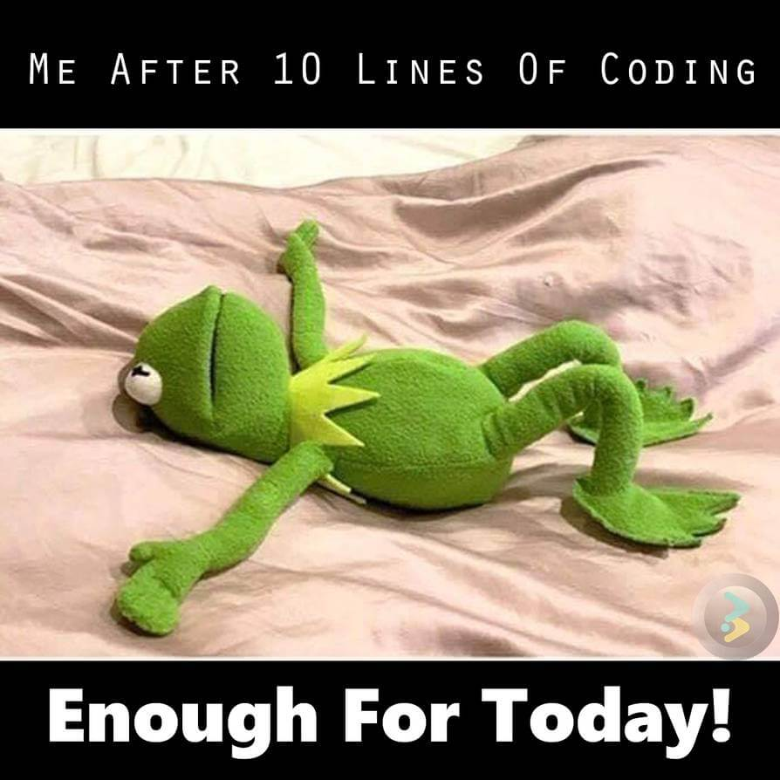
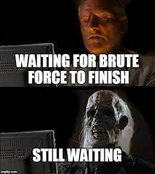
TIRED ?

Slide 6
Two pointer approach :
We take two pointers, one representing the first element and other representing the last element of the array
Then we add the values kept at both the pointers.
If their sum is smaller than X then we shift the left pointer to right
If their sum is greater than X then we shift the right pointer to left, in order to get closer to the sum
We keep moving the pointers until we get the sum as X.

Slide 7
CODE (OPTIMAL APPROACH):
bool isPairSum(A[ ], N, X) {
int i = 0;
int j = N - 1;
while (i < j) {
if (A[i] + A[j] == X) return true;
else if (A[i] + A[j] < X) i++;
else j--;
}
return false;
}

Slide 8
Example 2 :
Problem
Always think of Brute Force First !

Slide 9

Break Problems into sub-problems .
How can you store unique elements?
Think of STL.
How can you store unique ones at start?
Take out elements from STL and place them.
Pretty simple, isn’t it?

Slide 10
Analysis of Brute Force Approach
Time Complexity - O(NlogN)
Space Complexity - O(N)
CHALLENGE ?
Reduce Time and Space Complexity to-
TC - O(N)
SC - O(1)

Slide 11
CODE (TWO POINTER) -
int removeDuplicates(vector<int>& nums){
int n=nums.size();
int i=0,j=1;
while(j<n){
if(nums[i]==nums[j]) j++;
else{ i++;
nums[i]=nums[j];
j++; }
}
return i+1;
}

Slide 12
PRACTICE QUESTIONS :
Practice Question 1
Practice Question 2
Practice Question 3
Practice Question 4
HAPPY LEARNING ;)

